Slide 1
Discussion Module:
Discussion/Information Only-
Anything less than (n) nodes and (mGB) data can produce spurious results. A capacity planning and tuning lab exists in the advanced class; 14 + nodes, plus driver nodes, production sized data, other.
Topics related to capacity planning
Topics related to tuning
DSE Search specific only
Capacity Planning and Tuning
Notes:
The goal of this Discussion Module is to detail topics related to DSE Search capacity planning and tuning. Comments:
Prerequisites to this discussion include that the attendee is versant on this same topic (capacity planning and tuning) as it pertains to DSE Core.
Tuning exercises on smaller systems with under sized data volumes can produce spurious results; rounding errors, other. For that reason (not having sizeable data and hardware for an overview discussion), this module is not currently accompanied by a lab.

Slide 2
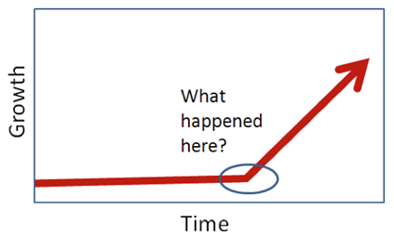
Discussion Lab:
Discuss
Notes:
On the next page we enter a Discussion Lab.

Slide 3
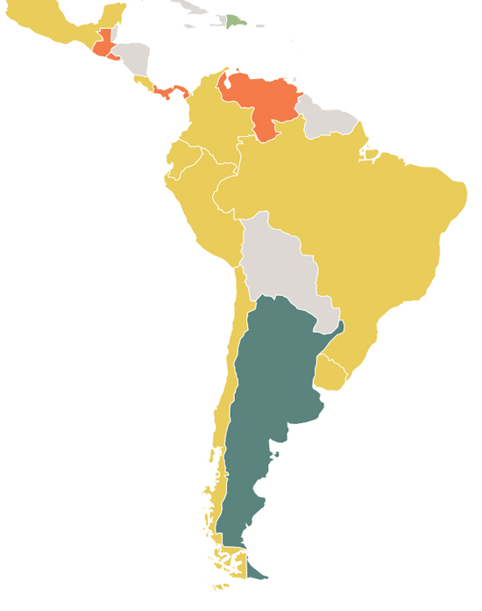
Background:
Fictitious company operates out of Miami, with stand alone production servers/data centers in all/most countries in S.America and LATAM.
Shared development/test server; 24 cores, 84 TB disk
Explosive growth over 7-10 years-
Production servers in Brazil, Mexico become 12x to 48x larger than development/test
No real HA disaster planning/test. Best estimate is to serve a (failed) country out of an adjacent country/server
Highly spikey system load; imagine pay per view on World Cup Soccer style events
Too much unplanned downtime
Notes:
This is not a true story- Names have been changed anyway.
A given customer serves the markets listed above, with the runtime environment as described.

Slide 4






Vendor <- -> Customer
When I give you this patch, what is your level of comfort that this will solve the production problem ?
Zero, In fact, you’ve given us patches before that have brought production down, and that can’t happen again.
The last time you did (recovery procedure x); How long did that take ?
We haven’t done that in 6-8 years. Since that time production volumes have gone up 48x. This can’t take more than (n) time, and it can’t affect production.
www.snoopy.com
Notes:
Net/net, test and Q/A platforms are no longer representative with production (and poor practices are in place).

Slide 5
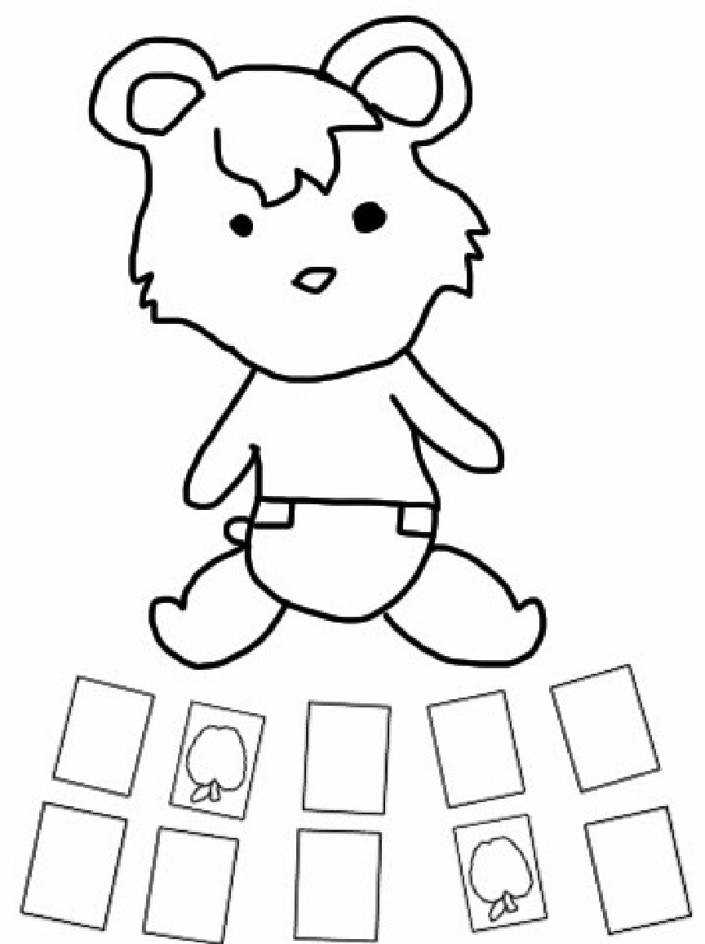


Best / Not-Best Practice ?
Testing on representative hardware
Testing/developing on production sized data
Having a ready/representative test (query) harness
Having a Rabbit’s Foot
http://knowyourmeme.com/photos/1080551
Notes:
Matching pairs Discussion Lab: Best Practice, Not Best Practice-
Match the terms on the right with the Best/Not-Best label on the left.

Slide 6
End of Discussion Lab:
Notes:
End of Discussion Lab-

Slide 7
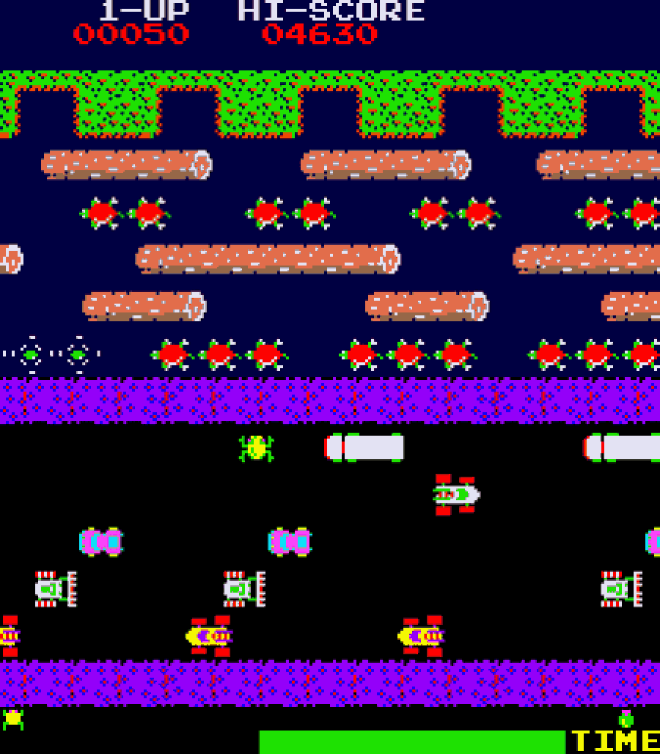
DSE Search: Cap Planning, Tuning-
System tuning
Statement tuning (queries)
Prod sized data, repeatable test harness, isolation
Frequency, concurrency, spread
One variable; rinse, repeat
http://www.classicgaming.cc/classics/frogger/about
Notes:
On the topic of capacity planning and tuning DSE Search, there is system tuning, and statement tuning. Comments:
System tuning involves; disk controller, and disk/data placement, (global) settings in cassandra.yaml, dse,yaml, Linux kernel settings, others.
Depending on your starting point, and the number of errors previously made, system tuning generally yields 5-35% greater performance. It is unlikely you can move a 4 minute query to a 5 second query through system tuning.
Statement tuning involves the dozens/hundreds/thousands of (end user) initiated CQL statements that run against the DSE server.
Having captured those statements, we seek to categorize them by; frequency, concurrency, and spread. Reference to the 1900’s video game titled, Frogger.
We seek also to capture the required and observed SLA per statement. If a given statement was executing at 5mx, and increasing 1 ms in execution time per month, that’s a different problem to solve than a statement that jump by an additional 4s of execution time overnight.

Slide 8
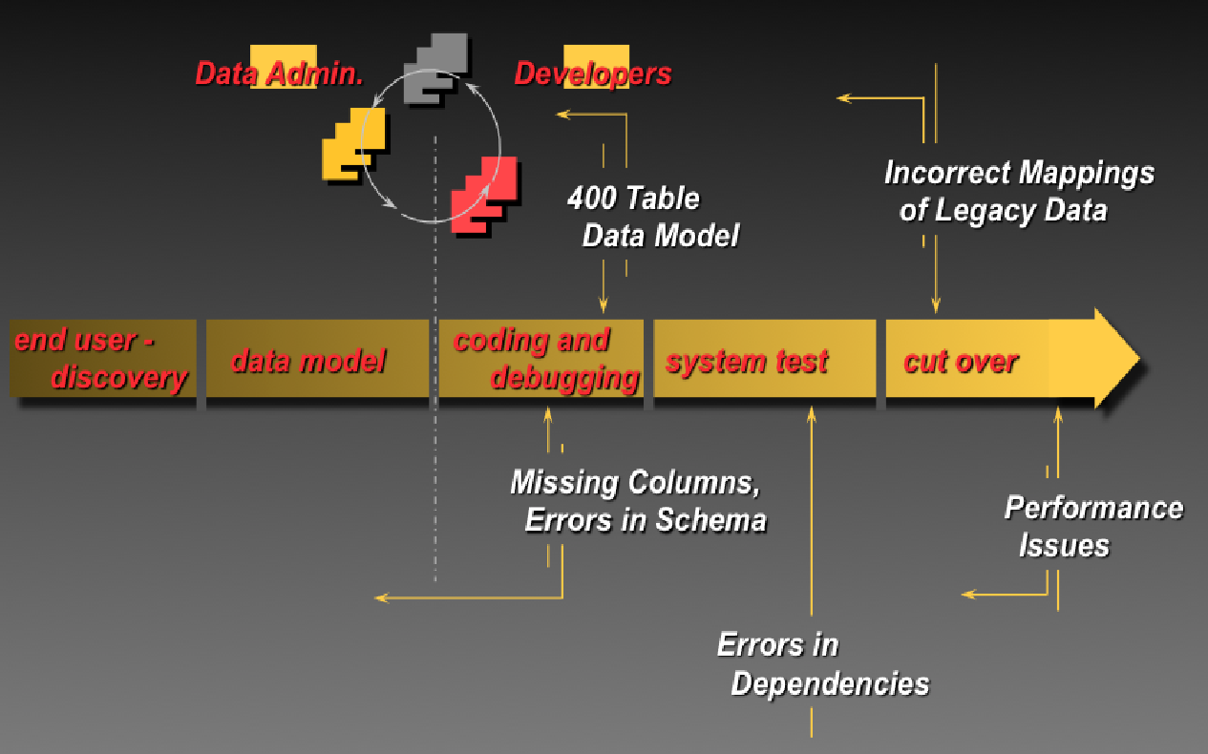
Common SDLC, and Issues
Notes:
Hopefully (best practice), the query test harness was captured during development and is still active. Comments:
The image above depicts a 5 stage new application development effort software development effort.
It is highly recommended that one develops and test the query on production sized (real, legacy) data after the data model is complete, and before any application development begins. Why ? At this point you can uncover performance issues and related, and change the model while the impact to existing code is nill.

Slide 9




DSE Search: DCs, Read/Write, Load isolation
Data Center 1
DB
Data Center 2
DB
Network
Interruption
DB
DB
DB
DB
DB
DB
App
App
Clients
Clients
Notes:
Recall that DSE can isolate workload by groups of nodes, by data center.
So, while the mission critical (low SLA) writes are occurring in DC-1, the DSE Search queries can be pushed to DC-2; a nice and easy resource governing and guarantee system. The DSE Search index updates will still have to happen in DC-2. However, the query activity in DC-2 should not measurably impact DC-1.

Slide 10
If you don’t have the Query Harness-
1
CQL Slow Log (dse.yaml. perm)
enabled
threshhold_ms
ttl_seconds
async_writers
dsetool perf cqlslowlog enable (temp)
dsetool perf cqlslowlog 1000
SELECT * FROM dse_perf,node_slow_log;
Developers
This is something someone should have created/maintained
Reverse engineering is not forecasting, signing your name to something
2
Notes:
The next two pages discuss (reverse engineering) the query harness if you do not possess it. Comments:
Improperly set, any of these logging settings can become intrusive performance wise.
The CQL slow query log can be enabled in multiple ways.
Generally, all of the data that follows is available under the dse_perf keyspace.

Slide 11

If you don’t have the Query Harness-
Solr Slow Sub-query Log
dsetool perf solrslowlog enable
dsetool perf solrindexstats enable
dsetool perf solrcachestats enable
dsetool perf solrlatencysnapshots enable
SELECT * FROM dse_perf.solr_slow_sub_query_log;
SELECT (8-10 others)
DSE Audit Secure subsystem
https://docs.datastax.com/en/dse/6.0/dse-admin/datastax_enterprise/security/secAuditEnable.html
4
_
DSE Ops Center
Search requests, latencies, timeouts, errors
Index size
3
Notes:
There is also a distinct log for just DSE Search (Solr) queries.
The DSE Audit Secure subsystem can also be used to gather query information.
After these steps you will have generated a large amount of data to sort, reduce, other. You may need to use Excel or your Linux text processing skills to identify the most important queries.
Data can also be retrieved from DSE Ops Center.

Slide 12
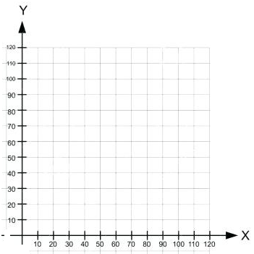
Start working the (graph)
Not cost effective to fix every query; Pick the top n% that you have time for
Index only necessary columns
CREATE SEARCH INDEX ON t1;
First graph vertex predicate
Is it a better DSE Core index or DSE Search index application-
Duration
Frequency of Query
Notes:
It’s not cost effective to tune all (1000) queries; pick the most offensive and work down the list.
Also create a list of every index in place, and start associating those indexes with known queries. IF you aren’t using an index (but still must maintain it), drop the index.

Slide 13
Start working the (graph)
CQLSH (driver); tracing on
Solr Admin UI screen
CQL statement tuning
(Everything/most you know from SQL)
Leading wildcards, complex expressions
Index negation statements; OR topped
Unnecessary sorts
Casting
If it doesn’t reduce network comm, move to the client tier
Query Metrics Mbean
jmxterm, other
com.datastax.bdp -> search -> (core name) ->
QueryMetrics
IndexPool
CommitMetrics
UpdateMetrics
Latency counts, latency percentile, average latency
Read path phases; coordinate, execute, retrieve
Notes:
“tracing on” in CQLSH, or the client side drivers, offer really good latency and query processing data. So does the JMX interface to DSE.
The net/net becomes; experiment with different CQL SELECT syntax and requirements to improve performance.

Slide 14
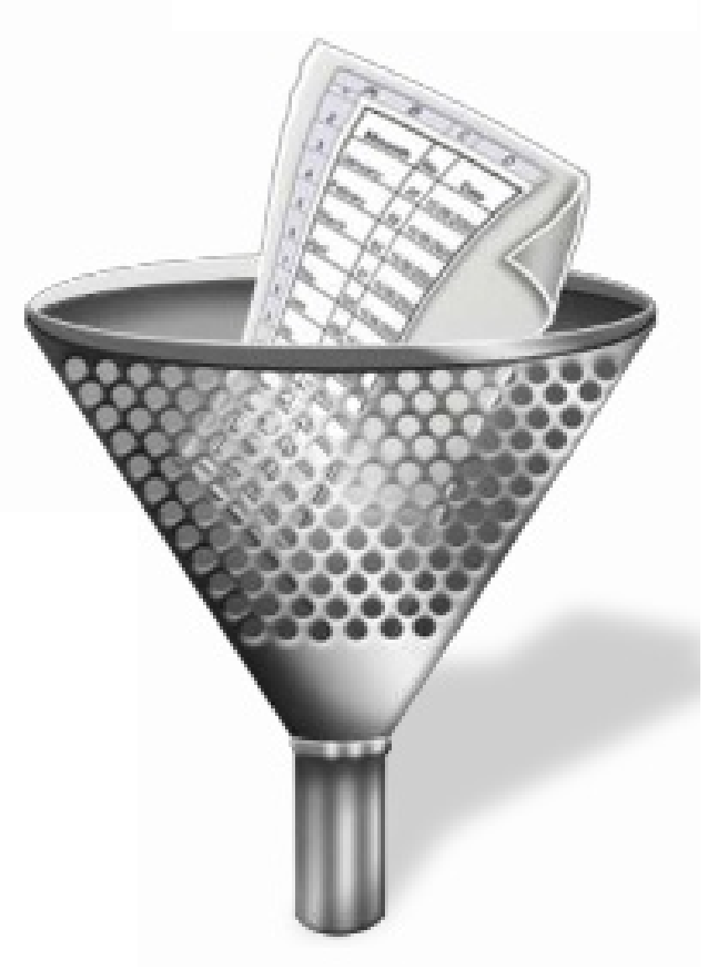
“q” and “fq”
filtercache
Easiest/most-common means to OOM
dse.yaml – ramBufferSizeMB, ram_buffer_heap_space_in_mb
solrconfig.xml, highWaterMarkMB=“256”, lowWaterMarkMB=“128”
dse.yaml (pre 6.0) – max_solr_concurrency_per_core, back_pressure_theshhold_per_core
Notes:
There is a syntactical means to drive how a DSE Search query caches its result sets.
DSE Technical Support will state that using filter cache (“fq”) is the fastest, most common, means that new users cause out of memory errors; so, use with great care.
The tunables to filter cache are listed above.

Slide 15

Call to Action-
We’ve outlined the knobs-
It’s about changing one variable at a time; careful testing
Invest in the query harness
Remember the incremental issue versus overnight ? Two very different problems.
http://picsnook.com/sunset-desert-minimal-4k-hd-wallpaper/
Notes:
Net/net, and call to action:
Faster is faster, and slower is slower.
Change one variable at a time; repeatable steps, careful (repeated) measurement.
Invest in having an accurate test/query harness. Not only is this a necessary tool, but the data it produces offers insight.

Slide 16
End of Module:
Notes:
End of Discussion Module-

